Slide 1
General announcements
Test 2 is Wednesday
~2/3 vectors (see Vector Practice Problems on class Website - be able to do those sorts of questions in both unit vector and polar notation)
~1/3 projectiles (a couple of problems involving 2D motion as we’ve done in class)
Probably a few multiple choice questions (see practice MC on Website)
There will be a Chipotle night Monday from 5:30-7:00 pm
TILTED TABLE LAB:
Due after Trips Week. . .
TO CATCH A BALL LAB:
Friday is the day of judgement! We’ll see what you’ve got…

Slide 2
To Catch A Ball
You and your partner(s) have a few minutes to chat and see if you’re on the same page.
Take your data to determine your velocity.
At NO POINT should the ball be allowed to roll off the table onto the floor while taking preliminary data. You will automatically lose 5 points if this happens.
Once you have your data, calculate and predict the location of the cup to catch the ball. When you have a distance you all agree on, just wait. We will all make our run at the same time . . . (oh, the fun!!!).
If, for some reason, we test at different times, once you’ve tested and are waiting for others to finish, try problems 3.27 and 3.32 and 3.29 (on class Website in the XtraWrk PDF).

Slide 3
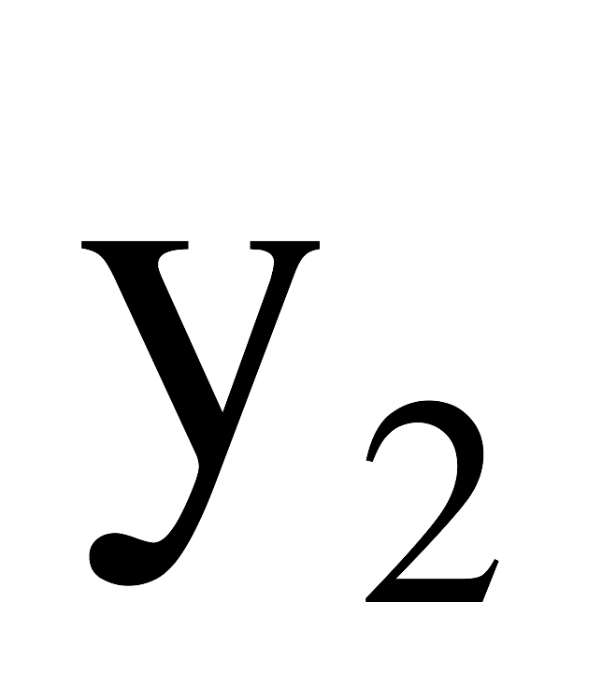
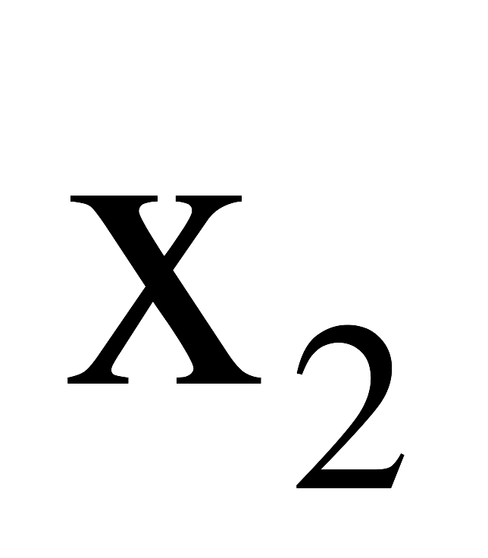
To Catch a Ball lab
table
cup
floor

